Slide 1
3413ICT Network Security
Network Anomaly Detection
Dr V. Muthukkumarasamy
B.Sc.Eng (Hons) (Peradeniya), PhD (Cantab), MIEE, MIEEE

Slide 2
Previous Lecture…
Have studied…
Security assurance
Overview of security assurance
Distinguish security & software assurance
Process management
Key aspects of technical perspective

Slide 3
Today’s Objectives
Network intrusions
Why anomaly detection
Evaluation of anomaly detection
Applications of anomaly detection
Classification-based techniques
Nearest neighbour based techniques
Case study: MINDS
Notes:
Now look at a simple form of encryption based on two concepts: the block cipher and the stream cipher.
Stream ciphers are based on a PRNG. The strength of the cipher depends on just how good the PRNG is. Good algorithms employ a lot of state and are highly secure. Stream ciphers must never re-use the same key and many mistakes occur because of this (Word/Excel encryption, WEP and so on).
With the block cipher method, the message is divided into blocks, i.e., 64 or 128 bit blocks, and then each block is transformed using the algorithm and key.

Slide 4
References
This lecture is based on
“Anomaly detection: a survey”, by V. Chandola, A. Banerjee, V. Kumar (University of Minnesota), published in ACM Computing Surveys, 41 (3), 2009.
Some concepts are from:
(Textbook), Computer Security Principles and Practice (2nd Ed.), W. Stallings & L. Brown, Chapter 8
(Textbook), Network Security Essentials Applications and Standards (4th Ed.), W. Stallings, Chapter 9

Slide 5


Network Intrusion
A significant security issue for computer networks is hostile or unwanted access
Other threats include DoS attacks and DDoS attacks
Both are launched via network (and/or from the Internet)
Any solutions?
Monitor traffic and behaviour
Report when attacks are detected

Slide 6
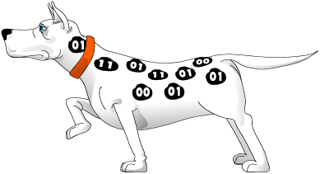


Types of Detection
Signature-based intrusion detection
Network-based intrusion detection
Host-based intrusion detection

Slide 7

Types of Detection
Signature-based intrusion detection
Network-based intrusion detection
Host-based intrusion detection
Anomaly detection

Slide 8
Why Anomaly Detection?
Traditional intrusion detection systems (IDSs) don’t work well in detecting emerging intrusions
There was no effective tools to detect DoS and DDoS attacks
……

Slide 9

What is Anomaly ?

Slide 10
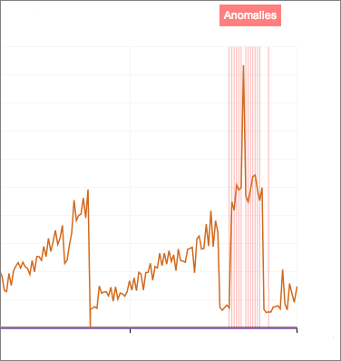
What is Anomaly ?

Slide 11
What is Anomaly ?
What is anomaly?
Anomaly is a pattern in the data that does not conform to the expected pattern or behavior
Also referred to as outliers, exceptions, etc.

Slide 12
Abnormal Network Behaviour
Attempted break-in: It might generate an abnormally high rate of password failure with respect to a single account
Successful break-in: Someone logging into a system through an unauthorized account might have a different login time, location, or connection type. In addition, the intruder might spend most of his time browsing through directories and executing system status commands, whereas the legitimate user might concentrate on editing or compiling and linking programs
Leakage by legitimate user: A user trying to leak sensitive documents might log onto the system at unusual times or route data to remote printers not normally used
Inference by legitimate user: A user attempting to obtain unauthorized data from a database through inference might retrieve more records than usual

Slide 13
How to Represent Anomaly
Using points in 2D or higher dimensional space:
Y
N₁
o₁
O₃
o₂
N₂
X

Slide 14
How to Represent Anomaly
Using points in 2D or higher dimensional space:
Points in the regions N₁ and N₂ can be normal data items
Y
N₁
o₁
O₃
o₂
N₂
X

Slide 15
How to Represent Anomaly
Using points in 2D or higher dimensional space:
Points in the regions N₁ and N₂ can be normal data items
Points o₁ and o₂ are anomalies
Points in region O₃ are anomalies
Y
N₁
o₁
O₃
o₂
N₂
X

Slide 16
Key Challenges
Defining a representative normal region is challenging
Data might contain noise
Normal data behaviour keeps evolving

Slide 17

Key Challenges
Defining a representative normal region is challenging
Data might contain noise
Normal data behaviour keeps
evolving
“Mining needle in a haystack. So much hay and so little time”

Slide 18
Key Challenges
Defining a representative normal region is challenging
Data might contain noise
Normal data behaviour keeps
evolving
Very small amount of anomaly in a huge amount of data
Need very efficient algorithms
……
“Mining needle in a haystack. So much hay and so little time”

Slide 19
Input Data for Anomaly Detection
Most common form of data handled by anomaly detection techniques is Record Data, which can be
Univariate
Multivariate
19

Slide 20
Data Labels
Supervised anomaly detection
Labels available for both normal data and anomalies
Semi-supervised anomaly detection
Labels available only for normal data
Unsupervised anomaly detection
No labels assumed
Based on the assumption that anomalies are very rare compared to normal data

Slide 21
Type of Anomaly
To identify anomalies from given record data, we may need to consider the context (i.e., conditions, or environments) or the whole system
Anomalies can be categorized into the following two types:
Point Anomalies (global anomalies)
Contextual Anomalies (conditional anomalies)

Slide 22
Point Anomalies
An individual data record is viewed as anomalous with respect to the data, without considering other conditions
Y
N₁
o₁
O₃
o₂
N₂
X

Slide 23
Conditional Anomalies
An individual data instance is anomalous within a context
Anomaly
Normal
* X. Song, M. Wu, C. Jermaine, S. Ranka, “Conditional Anomaly Detection,”
IEEE Transactions on Data and Knowledge Engineering, 2006.

Slide 24
Output of Anomaly Detection
Label
Each test instance is given a normal or anomaly label
This approach is used in classification-based techniques of anomaly detection
Score (fuzzy logic method)
Each test instance is assigned an anomaly score
Allows the output to be ranked
Requires an additional threshold parameter

Slide 25
Accuracy of Anomaly Detection
“Accuracy” is not sufficient metric for evaluation
An example:
Network traffic data set with 99.9% of normal data and 0.1% of intrusions
Trivial detector that labels everything with the normal class can achieve 99.9% accuracy ! ?
Researchers are working on establishing better criteria
Notes:
25

Slide 26


Applications of Anomaly Detection
Network intrusion detection

Slide 27

Applications of Anomaly Detection
Network intrusion detection
Healthcare informatics / Medical diagnostics

Slide 28

Applications of Anomaly Detection
Network intrusion detection
Healthcare informatics / Medical diagnostics
Industrial damage detection
……

Slide 29
Techniques for Anomaly Detection
Classification-based techniques
Nearest neighbour based techniques
Distance based methods
Density based methods
Clustering based techniques

Slide 30
Classification-Based Techniques
Build a classification model for normal and anomalous events, based on labelled training data; then use it to classify each new event
May require:
knowledge of normal and anomaly classes
at least, knowledge of normal class

Slide 31
Nearest Neighbour Based Techniques
Key assumption:
Normal points have close neighbours while anomalies are located far from other points
Categories:
Distance based methods
Anomalies are data points most distant from other points
Density based methods
Anomalies are data points in low density regions

Slide 32
Distance Based Approach
kNN (Nearest Neighbour) approach
For each data point d, compute the distance to the k-th nearest neighbour d_{k} (which is called k-distance)
Sort all data points according to the distance d_{k}
Outliers are points that have the largest distance d_{k,} and therefore are located in the more sparse neighbourhoods
Usually data points that have top n% distance d are identified as outliers
- where k and n are parameters based on security requirements

Slide 33
Density Based Approaches
Local Outlier Factor (LOF) – proposed by Breunig, et al, in 2000
For each data point A, compute the distance to the k-th nearest neighbor (the k-distance)
Compute reachability distance (reach-dist) for each data point B with respect to A, as
reach-dist_{k}(B, A) = max{k-distance(A), d(B, A)}

Slide 34
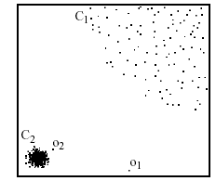
Advantages of Density based Techniques
Local Outlier Factor (LOF) v.s. kNN
In the kNN approach, p₂ is not considered as outlier, while the LOF approach finds p₂ as an outlier
Distance from p₃ to nearest neighbor
p₃
×
Distance from p₂ to nearest neighbor
p₂
×
p₁
×

Slide 35
Conditional Anomaly Detection
General Approach
Identify a context around a data instance (using a set of contextual attributes or features)
Determine if the data instance is anomalous w.r.t. the context (based on the set of attributes)
Advantages
It can detect anomalies that are hard to detect when analysed in the global perspective
Challenges
Identifying a set of good contextual attributes

Slide 36


Case Study: MINDS
An anomaly detection system was developed by Univ of Minnesota and Army Research Lab to detect various suspicious activities
called MINDS (Minnesota Intrusion Detection System)
Outperforms traditional tools, like SNORT
MINDS
MINDS
Association pattern analysis
Summary and characterization of attacks
Anomaly scores
network
Anomaly detection
…
…
Detected novel attacks
MINDSAR
Human analyst
Data capturing device
Net flow tools
tcpdump
Labels
Filtering
Feature Extraction
Known attack detection
Detected known attacks

Slide 37
Network Intrusion Detection
Traditional intrusion detection system IDS tools (e.g. SNORT) are based on signatures of known attacks
www.snort.org
Limitations
Signature database has to be manually revised for each new type of discovered intrusion
Substantial latency in deployment of newly created signatures across the computer system
Difficult to detect emerging cyber threats
MINDS can alleviate these limitations

Slide 38
Features for MINDS Detection
Three groups of features
Basic features of individual TCP connections
source & destination IP Features 1 & 2
source & destination port Features 3 & 4
Protocol Feature 5
Duration Feature 6
Bytes per packets Feature 7
number of bytes Feature 8
Time based features
For the same source (destination) IP address, number of unique destination (source) IP addresses inside the network in last T seconds – Features 9 (13)
Number of connections from source (destination) IP to the same destination (source) port in last T seconds – Features 11 (15)
Connection based features
For the same source (destination) IP address, number of unique destination (source) IP addresses inside the network in last N connections - Features 10 (14)
Number of connections from source (destination) IP to the same destination (source) port in last N connections - Features 12 (16)

Slide 39
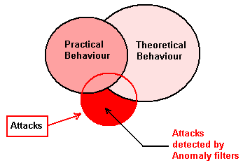
Intrusion Detection Systems – Anomaly Based (Sithirasenan et. al.)

Slide 40
The Early Warning System (EWS)
EWS Block Diagram (Sithirasenan et. al., AusWireless’06)

Slide 41
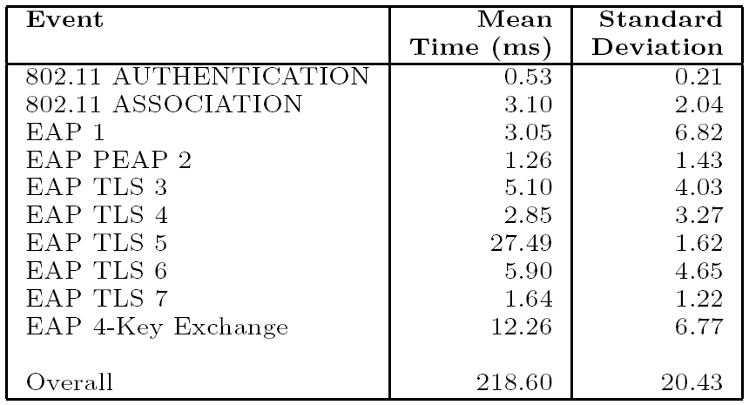
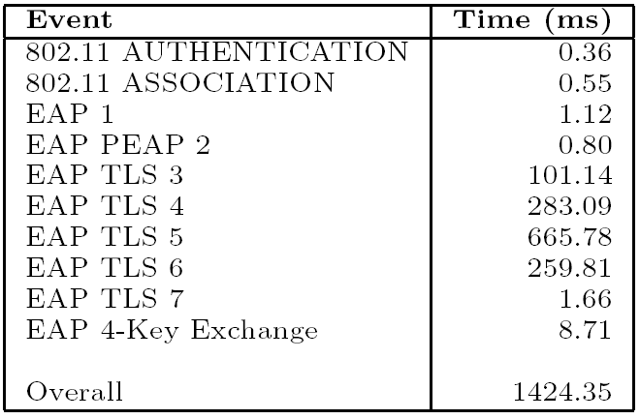
Timing Anomaly Detection Timing Profiles
EAP-TLS Timing Profile
Abnormal EAP-TLS Timings
Timing Profiles (Sithirasenan et. al., IEEE CCNC’ 07)

Slide 42
Behaviour Anomaly Detection Behaviour Profiles
Abnormal EAP-TLS
Normal EAP-TLS
Behaviour Profiles (Sithirasenan et. al., IEEE CCNC’ 07)

Slide 43
RSN Behaviour: In “Behaviour Tree”
RSN Projection (Sithirasenan et.al., AusCERT’05)

Slide 44
Data Analysis OLAP
Online Analytical Processing (OLAP)
Interactive analysis of data, allowing data to be summarized and viewed in different ways in an online fashion (with negligible delay)
Data that can be modeled as dimension attributes and measure attributes are called multidimensional data.
Measure attributes
measure some value
can be aggregated upon
e.g. the attribute number of the sales relation
Dimension attributes
define the dimensions on which measure attributes (or aggregates thereof) are viewed
e.g. the attributes item_name, color, and size of the sales relation

Slide 45
The Data Cube Views
Attribute | Description
A | Source ID
B | Destination ID
C | Event
D | Time of Day
E | Channel ID
F | Protocol ID
G | Cipher ID
Views Considered with Five Dimensions

Slide 46
The Data Cube Views Vs Threats
View Vs Threats (Sithirasenan et. al., IEEE ICON’ 07)

Slide 47
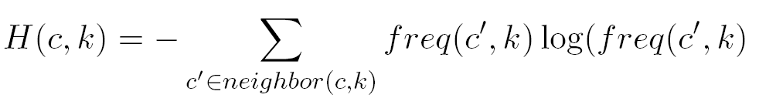

Group Outlier Score (GOS)
Confidence Level/GOS (Sithirasenan et. al., IEEE GlobeCOM’ 08)

Slide 48
Results: Accuracy (Sithirasenan et. al.)
Accuracy of our technique
with and without using substantiation is shown in the graph to the left.
The graph on the side shows the relationship between Accuracy and the Threshold Values for GOS. We get the best accuracy for a threshold value of 2.0.

Slide 49
Summary
Network intrusions
Why anomaly detection
Classification-based techniques
Nearest neighbour based techniques
Group Outlier Score technique

Slide 50

Questions?

